Slide 1
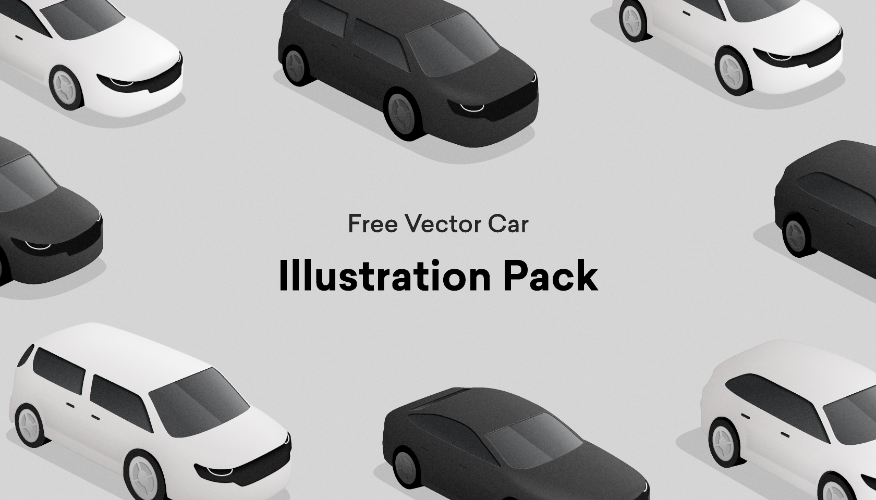


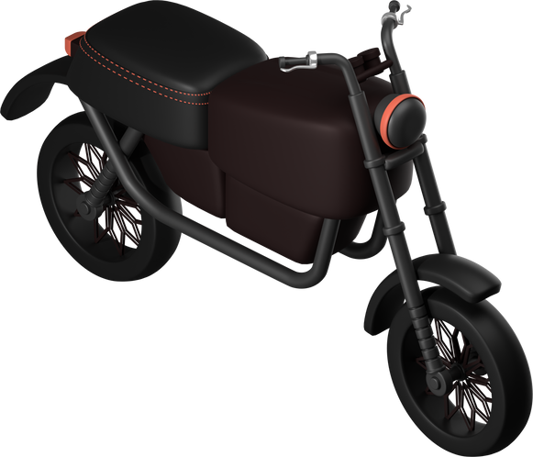
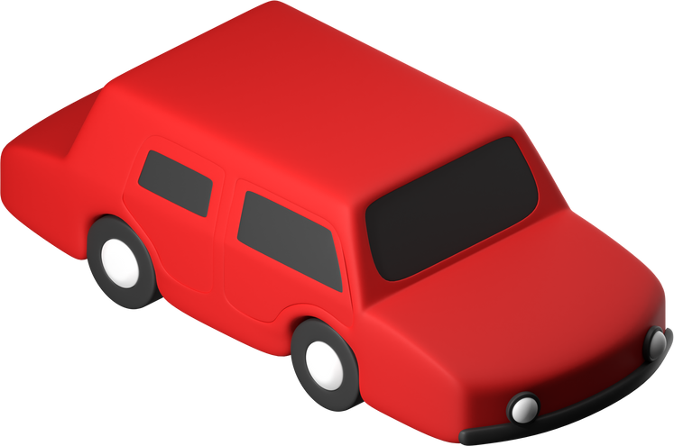
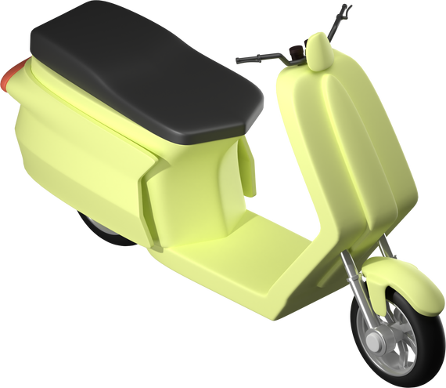






TinhLouk
TinhLouk: Where Reliability and Affordability Meet

Slide 2



How can I be sure that the information I get is accurate? And what if I encounter scams or fraud?
This is Amara
Amara is looking to buy a budget-size second-hand vehicle but struggles to find accurate information about the car's history and condition.

Slide 3

This is Dara
How can I ensure a safe and trustworthy selling experience?
Dara wants to sell his used car quickly but is worried about encountering fraudsters and scams.

Slide 4



Problems
In the world of buying and selling used vehicles, it is difficult to know who to TRUST!
85%
out of 68 surveys
Most people from age 25 to 50 are facing challenges such as:
1
Lack of trust
2
Risks of Scams and Fraud
3
Limited Access to Reliable Information
buyers and sellers often lack confidence in the accuracy of information within the second-hand vehicle market
the possibility of encountering tricking advertisements, forged documents, and misrepresented vehicle conditions
cannot obtain accurate information about the history, and condition of second-hand vehicles, resulting in uninformed purchase decisions

Slide 5





Solutions
A mobile application software where users can sell or buy second-hand vehicles.
AI-Powered Verification
1
Implement an image recognition technology to analyze posted images and verify that they are indeed vehicles.
Document Validation System
2
Create a secure document validation system that verifies critical documents such as ownership certificates, vehicle history reports, and user identities to prevent fraud/scam activities.
Foster connection between buyers and sellers
3
Offer a user-friendly messaging interface within the application and facilitate in-app meeting scheduling.
Verified User Profiles and Identities
4
Implement a verification process to ensure the authenticity of user-profiles and identities.

Slide 6
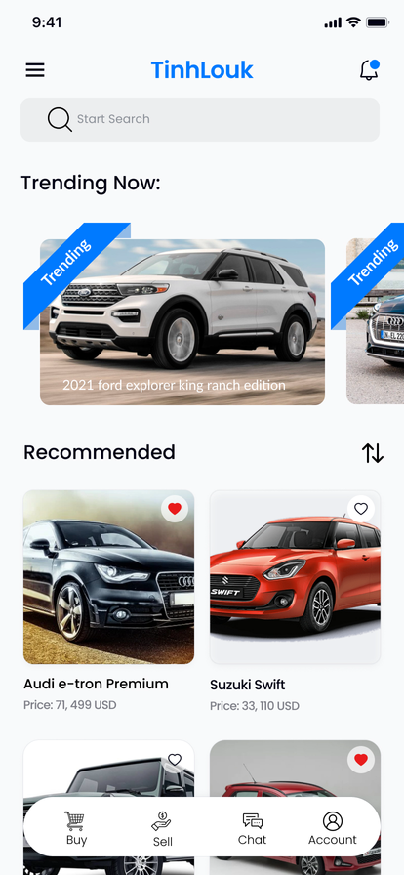
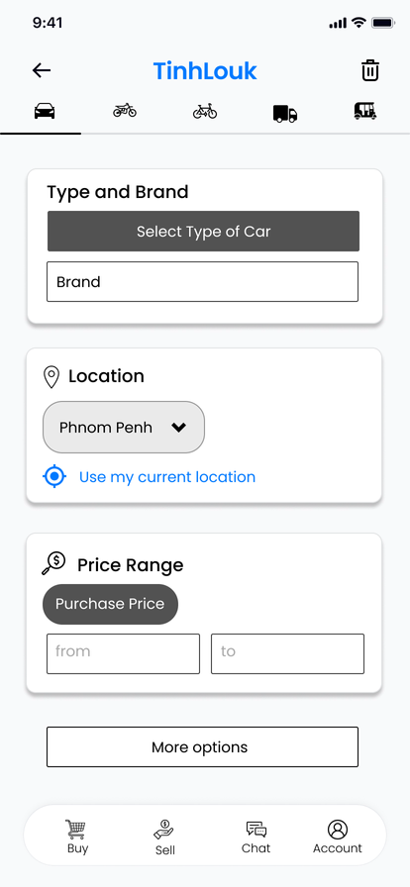
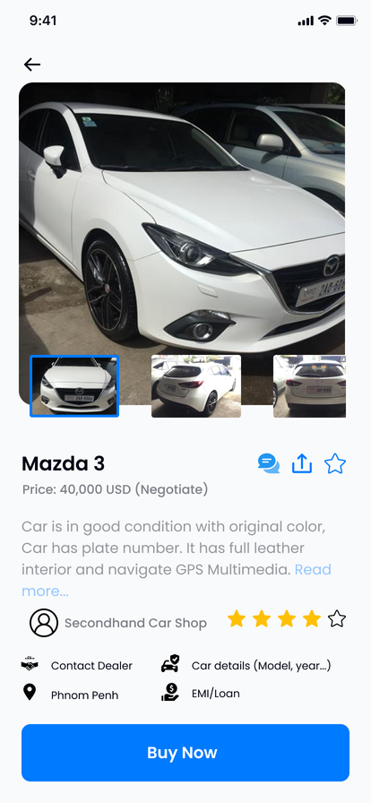
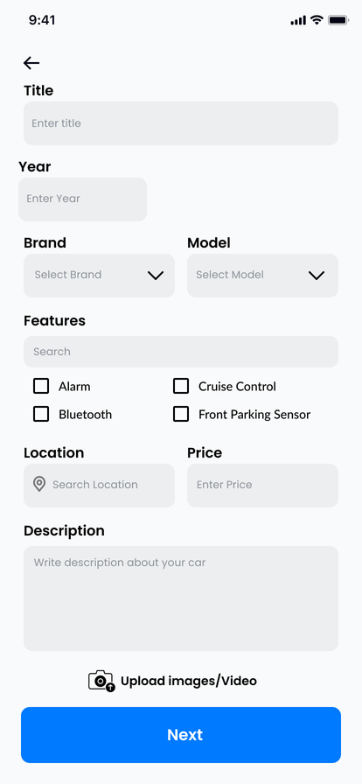
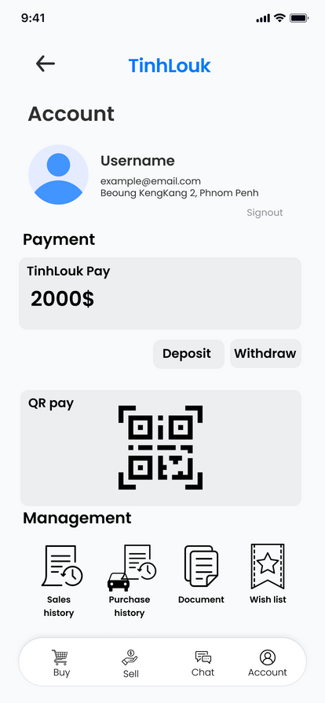
Features
Home Screen
Search Screen
Buy Car
Sell Screen
Account

Slide 7
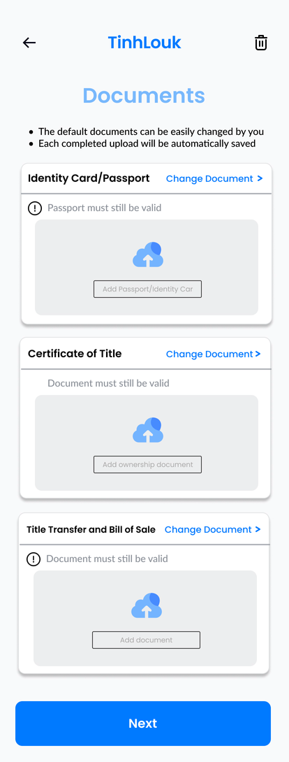
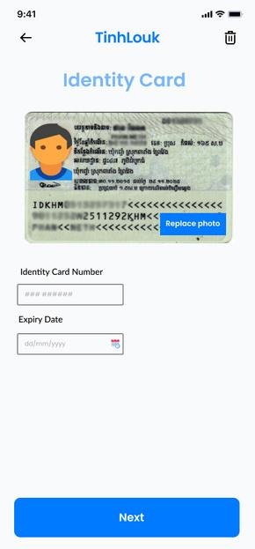
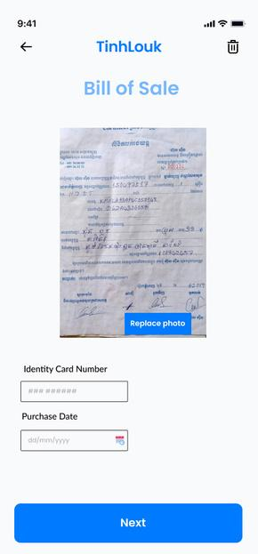
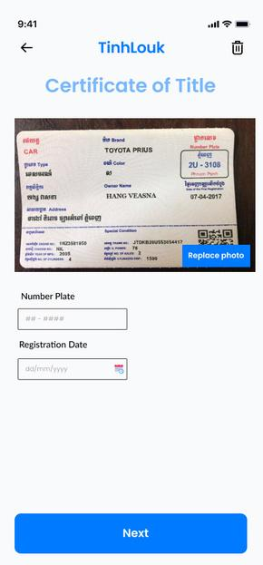
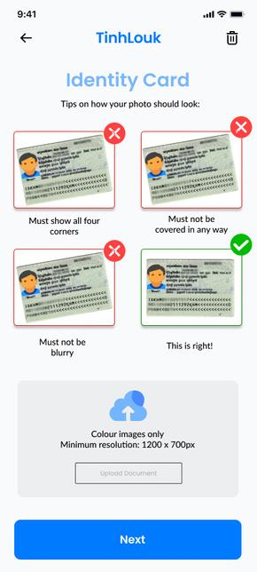
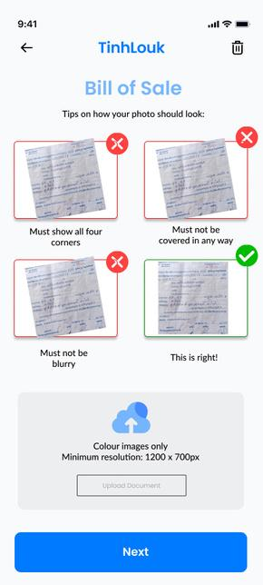
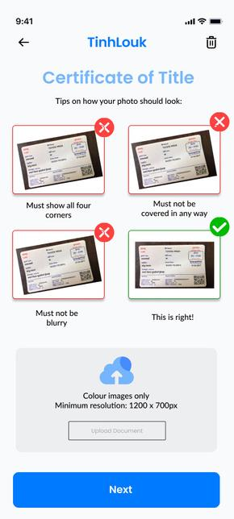
Features
Verification

Slide 8




Why TinhLouk?
TinhLouk’s document validation system verifies critical documents, including ownership certificates and vehicle history reports, ensuring transparency and reducing fraud risks.

Slide 9
Market Size
TAM
USD 20.6M
Cambodia’s market demand for second-hand vehicles
SAM
The market demand for second-hand vehicles aged from 15-64
USD 13M
SOM
The market demand for second-hand vehicles aged from 15-45
USD 1M
Sources:
https://www.marketresearchfuture.com/reports/used-vehicle-market-7616
https://www.mordorintelligence.com/industry-reports/south-east-asia-used-car-market
https://www.statista.com/outlook/mmo/passenger-cars/cambodia

Slide 10
Target Market
We target Cambodian users who seek to sell and buy second-hand vehicles that hold identity cards and driving license cards. There are 8M people aged (15-45), however, we only scope 30% of them which is equal to 2.4M (2, 400, 000) people
Aspect | Primary Users | Secondary Users | Potential Users
Who? | Retailers/Business Owners | Adult(15-35) | Old Adult(35-64)
Why? | Rely on the platform to sell their second-hand vehicles | Looking for their buying budget friendly vehicles | Seeking for buying affordable vehicles or selling their own vehicles
Sources: https://www.population-trends-asiapacific.org/data/KHM

Slide 11





Our Competitors
Khmer24 is a consumer-to-consumer marketplace platform to buy/sell their less used belongings like clothes, gadgets & accessories, cars & vehicles, etc.
MyKhmerCar is a website platform to buy & sell cars, motorbikes, and trucks in Cambodia.
VERIFIED USER PROFILE
DOCUMENT VALIDATION
CHAT SERVICE
USER RATINGS AND REVIEWS
MOBILE APPLICATION
Khmer24

Slide 12


Business Model
Advertisement
Commission Fee
Revenue will include advertising partnerships with renowned vehicle brands and businesses within the automative sector.
Our platform will charge 5% commission on successful second-hand vehicle sales, ensuring a fair fee structure for all users.

Slide 13



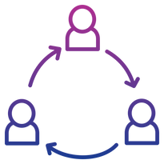
Market
Strategies
Goal: Reach 3,000 users by the end of 2024
Digital Marketing
Influencers
Referral Program
We are trying to target online advertisements to reach potential users interested in buying and selling second-hand vehicles.
We will collaborate with influencers to showcase the benefits of using our platform, highlighting the AI-powered verification system and secure document validation, etc.
We will launch a referral program that encourages existing users to refer new buyers and sellers to the platform in exchange for promotions or special offers.

Slide 14







Roadmap
We plan to sell important accessories for cars and basic maintenance
Vehicle Maintenance
Vehicle Accessories
engine oil maintenance service every 5,000 to 10,000 kms
sell phone mounts for every type of air vents
change of air filter every 15,000 to 30,000 kms
sell car / radio adapters
change of spark plugs every 30,000 to 100,000kms
sell car monitors for both android and apple
change of tires every 8,000 to 10,000kms
sell fuel additivie for every type of cars

Slide 15

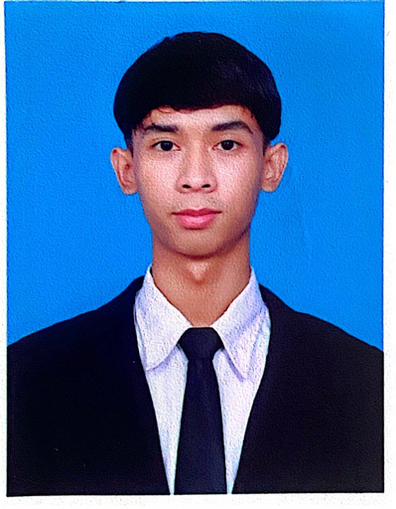
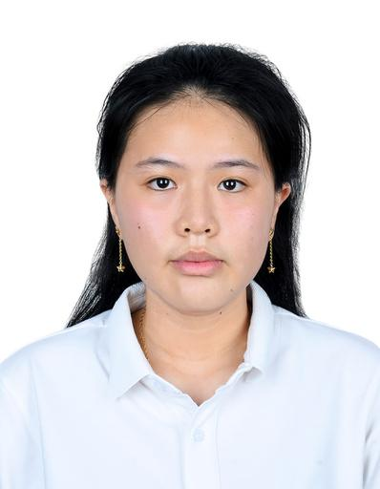
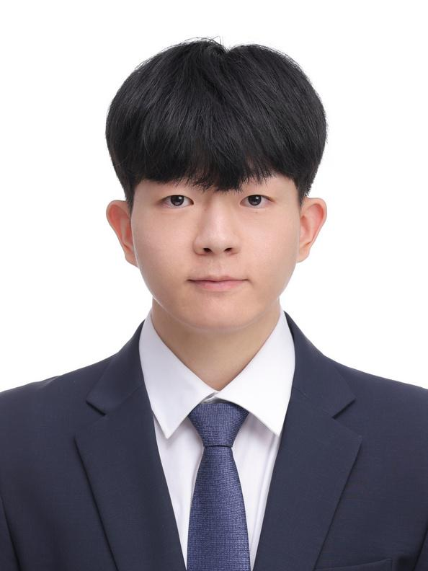
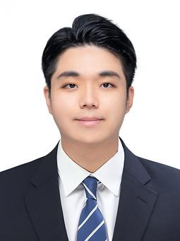
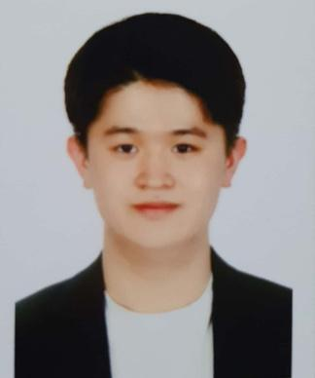
About Us
Men Monypothi
Visivai Mut
Lyheang Houng
Byeongheon Kim
Kookyong Shim
Yowhan Cha
Telecommunication and Electronics Engineering
Telecommunication and Electronics Engineering
Data Science and Engineering
Automotive SW Engineering
Automotive &
Entrepreneurship
Automotive
Engineering

Slide 16


Thank you
Contact Us
TinhLouk
tinhlouk@gmail.com

